Slide 1
Outpatient Rehab RVU Industry Responses
July 2022
Confidential – Patient Safety and Quality Improvement Work Product: Unless expressly stated otherwise, this document, and associated activities, are confidential and subject to all applicable privileges, including those provided pursuant to the Patient Safety and Quality Improvement Act of 2005, 42 C.F.R. § 3.206 (b)(4) and (5) ; A.R.S. § 36-445, et seq. and A.R.S. § 36-2401.

Slide 2
Survey Information
Dates in Circulation:
July 6th-July 20th (2022)
Distributor:
Elizabeth Linos, Director of Rehab
Recipients:
Industry colleagues
Sample Size:
15 Responses
Platform:
TypeForm Survey
Evaluated by:
Process Improvement

Slide 3
Confidential – Patient Safety and Quality Improvement Work Product: Unless expressly stated otherwise, this document, and associated activities, are confidential and subject to all applicable privileges, including those provided pursuant to the Patient Safety and Quality Improvement Act of 2005, 42 C.F.R. § 3.206 (b)(4) and (5) ; A.R.S. § 36-445, et seq. and A.R.S. § 36-2401.

Slide 4
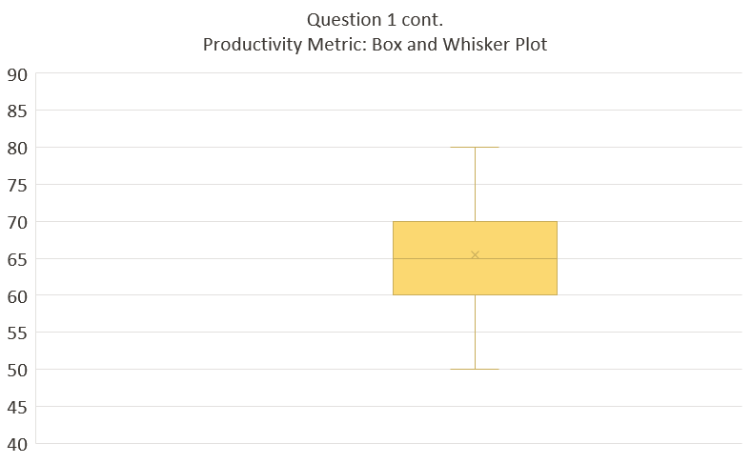
Mean=65.5
Median=65.0
Minimum=50.0
Maximum=80.0
Confidential – Patient Safety and Quality Improvement Work Product: Unless expressly stated otherwise, this document, and associated activities, are confidential and subject to all applicable privileges, including those provided pursuant to the Patient Safety and Quality Improvement Act of 2005, 42 C.F.R. § 3.206 (b)(4) and (5) ; A.R.S. § 36-445, et seq. and A.R.S. § 36-2401.

Slide 5
 | Question 2: What is your metric calculation for productivity?
Respondent 1 | RVUs
Respondent 2 | 15-minute timed units
Respondent 3 | Sessions per day (outliers)
Respondent 4 | Units per hour
Respondent 5 | 45 (outliers)
Respondent 6 | Unit of service
Respondent 7 | Billable time per paid time
Respondent 8 | 60% billed of available work
Respondent 9 | Units of service in 15-minute units
Respondent 10 | RVU per worked hour
Respondent 11 | RVUs per hour
Respondent 12 | Billed time based on weighted/worked hours
Respondent 13 | Therapy minutes per hour
Respondent 14 | Billable units per hour worked
Respondent 15 | Billed unit per worked hours
Confidential – Patient Safety and Quality Improvement Work Product: Unless expressly stated otherwise, this document, and associated activities, are confidential and subject to all applicable privileges, including those provided pursuant to the Patient Safety and Quality Improvement Act of 2005, 42 C.F.R. § 3.206 (b)(4) and (5) ; A.R.S. § 36-445, et seq. and A.R.S. § 36-2401.

Slide 6
Confidential – Patient Safety and Quality Improvement Work Product: Unless expressly stated otherwise, this document, and associated activities, are confidential and subject to all applicable privileges, including those provided pursuant to the Patient Safety and Quality Improvement Act of 2005, 42 C.F.R. § 3.206 (b)(4) and (5) ; A.R.S. § 36-445, et seq. and A.R.S. § 36-2401.

Slide 7
Question 5: What is included in your productivity rate? | All 15 | 4 Hospitals with 70-80% RVU included
Post-appointment documentation, letters of necessity, etc. | 40% | Yes
Schedule appointments | 40% | Yes
Education/training sessions | 33% | Yes
Admin tasks, physician follow-up, emails, etc. | 20%
Breaks | 20%
Family meetings | 20% | Yes
New mother breast milk pumping | 20%
Planning/prepping for each appointment | 20% | Yes
Cleaning between patient; put away supplies | 13%
Letters to community | 13%
Lunch | 13%
Meetings | 13%
Patient check-in | 13%
Preceptor oversight | 13%
PTO | 13%
Other* | 33%
Confidential – Patient Safety and Quality Improvement Work Product: Unless expressly stated otherwise, this document, and associated activities, are confidential and subject to all applicable privileges, including those provided pursuant to the Patient Safety and Quality Improvement Act of 2005, 42 C.F.R. § 3.206 (b)(4) and (5) ; A.R.S. § 36-445, et seq. and A.R.S. § 36-2401.

Slide 8
Confidential – Patient Safety and Quality Improvement Work Product: Unless expressly stated otherwise, this document, and associated activities, are confidential and subject to all applicable privileges, including those provided pursuant to the Patient Safety and Quality Improvement Act of 2005, 42 C.F.R. § 3.206 (b)(4) and (5) ; A.R.S. § 36-445, et seq. and A.R.S. § 36-2401.

Slide 9
Confidential – Patient Safety and Quality Improvement Work Product: Unless expressly stated otherwise, this document, and associated activities, are confidential and subject to all applicable privileges, including those provided pursuant to the Patient Safety and Quality Improvement Act of 2005, 42 C.F.R. § 3.206 (b)(4) and (5) ; A.R.S. § 36-445, et seq. and A.R.S. § 36-2401.

Slide 10
Confidential – Patient Safety and Quality Improvement Work Product: Unless expressly stated otherwise, this document, and associated activities, are confidential and subject to all applicable privileges, including those provided pursuant to the Patient Safety and Quality Improvement Act of 2005, 42 C.F.R. § 3.206 (b)(4) and (5) ; A.R.S. § 36-445, et seq. and A.R.S. § 36-2401.

Slide 11
Confidential – Patient Safety and Quality Improvement Work Product: Unless expressly stated otherwise, this document, and associated activities, are confidential and subject to all applicable privileges, including those provided pursuant to the Patient Safety and Quality Improvement Act of 2005, 42 C.F.R. § 3.206 (b)(4) and (5) ; A.R.S. § 36-445, et seq. and A.R.S. § 36-2401.
Notes:
Same

Slide 12
Question 10: Additional insights?
“…Therapists often work beyond their clinical FTE to meet all requirements...”
“We have coordinators who assist with complex scheduling.”
“We have an admin assist to schedule, insurance specialist to obtain auth, therapy techs to set up and clean up as well as provide support during sessions when needed. We expect 90% scheduling density each day to account for two 30-minute documentation/meeting times. Provided a one-hour lunch (we huddle for 15 minutes at 12:45 daily) and 30 minutes at the end of the day or the beginning of the next day to write notes/perform needed paperwork. Cancellation/no show rate at approx. 35%”
“We are currently evaluating our schedule templates to optimize access and productivity. Right now, 95% of appointments are scheduled for 60 minutes. We are exploring the potential for a template built on 45 minutes.”
Confidential – Patient Safety and Quality Improvement Work Product: Unless expressly stated otherwise, this document, and associated activities, are confidential and subject to all applicable privileges, including those provided pursuant to the Patient Safety and Quality Improvement Act of 2005, 42 C.F.R. § 3.206 (b)(4) and (5) ; A.R.S. § 36-445, et seq. and A.R.S. § 36-2401.

